Slide 1
Improving Betting in Cricket Using AI/ML
Team PISTOntails
- Achintya Dutta
- Ridham Bhagat
- Samarth Gupta
- Shaurya Singh

Slide 2
Introduction
Predicting the best possible 11 team in a cricket match for betting on apps like Dream11, Mobile Premier League (MPL) using Machine Learning and AI.
Our idea will help to bridge the gap between a knowledgeable guess and sheer luck.
With the ever increasing popularity of cricket and betting, our product will have a wide user base.

Slide 3
Features
Our Product would show the 11 players that should be picked by the user and which player should be made the captain and vice-captain (their points are multiplied by a factor depending on the betting website).
It would also predict how many runs/wickets/catches can be expected by the players and the entire team and what the final scorecard might looks like.

Slide 4
Targeted Business Problem
Curbing the losses sustained due to incomplete and inefficient statistics.
Generally, only the overall statistics of a player are shown, the statistics which are of utmost importance are covered under these umbrella statistics, these leads to partial knowledge while betting.
Betting is considered a Taboo in a lot of households due to the luck factor involved in it and hence there is a big untapped market.

Slide 5
Proposed Solution
We plan to make a website/app which will predict the performance of players and teams in the upcoming matches/tournaments using Machine Learning, Regression and Neural Networks.
This would help novice betters and even encourage more people to take part in betting as the Taboo which has been created around it can be reduced if it is given a more scientific outlook.
It would take into account various attributes of batting, bowling and fielding among other miscellaneous aspects which are covered in detail in the following slide.

Slide 6
Factors to be considered
Common | Batting | Bowling | Fielding | Miscellaneous
History with teams, players, stadiums, type of ball, tournament, pressure games/ situations. | Average against a particular type of bowling, Strike Rate, frequency of 4’s and 6’s. | Average, Economy, strike rate against right and left handed batsmen. | Accuracy and speed of throw. | Dimensions of the ground, expected weather conditions, type of pitch, home/away.
Recent Form and consistency. | Shot placement and frequency. | Line and Length of deliveries. Extras Conceded. | Fitness and agility. | Importance of match.
Various Shots and deliveries in the player’s arsenal. | Performance at various stages of the game. | Bowling at various stages of the game. | Fielding Position. | Player and Team Rankings.
Opponent Team Composition. | Balance, posture and stance. | Speed, Spin and swing on the ball. | Catches taken and dropped. | Injuries to Players.

Slide 7
Technology Stack
Technology
Artificial Intelligence
Machine Learning
Neural Networks
Languages
R
Python
Octave
Web Development
Php
Css
Miscellaneous
Microsoft Excel

Slide 8
Business Benefits
There is no single platform which show’s statistics in such depth, this would increase the traffic on the website.
Giving a more scientific approach to betting would incentivise and thus tap into the people who would want to bet but consider it a Taboo.
The product can be converted into an application.
This can be developed further to be used by various cricket teams to decide their team for the upcoming match. All professional cricket teams have analysts to find weaknesses of opponent players and strengths of their own.
The same concept can also be diverged into other sports.

Slide 9
Our Demo
The Demo Calculates scores for each player as batsman, bowler and fielder and also calculates the dream 11 score.
Players are assigned ranks from 1-5 based on their scores.
A Machine Learning Model is used to train & predict the fluctuation in ranks of players based on the data.
Using this prediction of ranks & the corresponding average dream11 scores computing the credit of a player.
Creating all possible team combinations(keeping in mind the restrictions on the team composition).

Slide 10
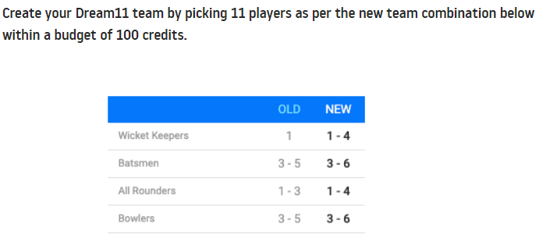
Dream11 Team Composition

Slide 11
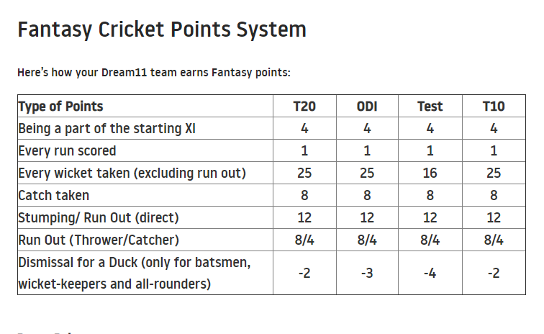
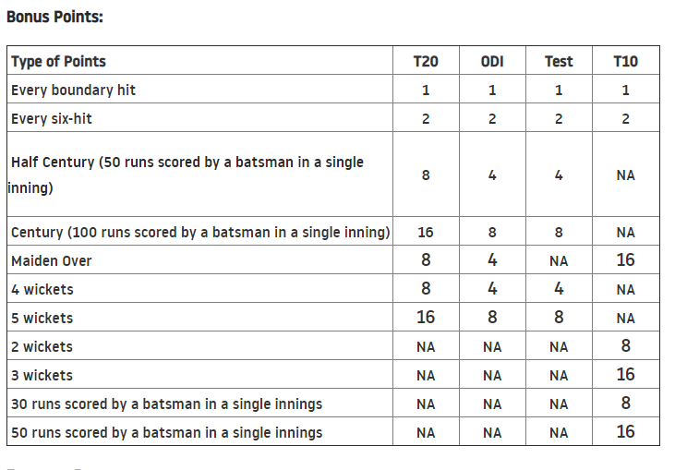
Dream11 Point System

Slide 12
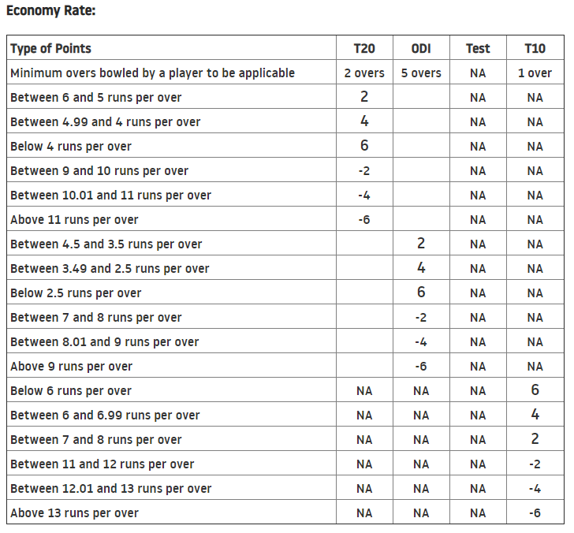
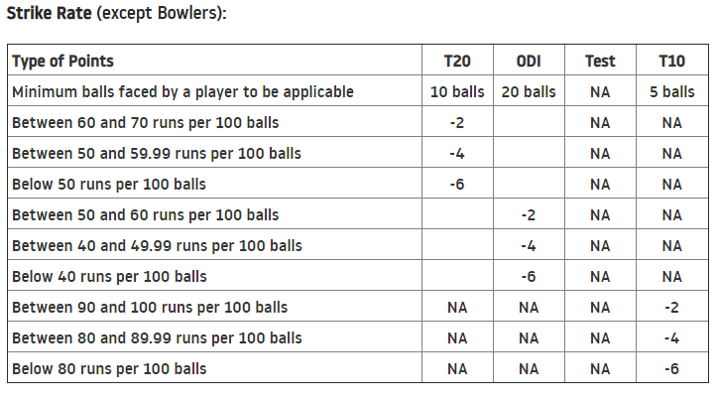


Slide 13
Next Steps
Initially had planned to predict the Dream11 team for IPL 2020 matches when submitting the idea, but due to the postponement we can’t exactly make the Dream11 team.
So instead, we made a dataset of IPL2019 and used the point system used by Dream11 to calculate a players points.
There is no dataset available, the type we wanted, and thus we had to make some alterations.
Next step will be to make a dataset with all the attributes and then apply Machine Learning, Decision Trees and Neural Networks on it to increase the accuracy of the product.

Slide 14
THANK YOU

